Slide 1
The Spectrum of Software Quality

Slide 2
Quality Attributes
Availability
Correctness
Reliability
Robustness

Slide 3
Availability
The availability of a system reflects its ability to deliver services when available (uptime/total time).:
Takes repair and restart time into account
Does not tend to take incorrect computations (partial failures) into account
Availability of 0.9999 means the system is available 99.99% of the time.
0.9 = down for 144 minutes a day, 0.99 = down for 14.4 minutes, 0.999 = down for 84 seconds, 0.9999 = down for 8.4 seconds.

Slide 4
Mean Time Between Failures
Mean time between failures (MTBF)
Average of intervals between consecutive failures.
Mean time to failures (MTTF)
Average amount of time a system operates before it fails
Mean time to repair (MTTR)
Average time to repair/restart the system and get it back to running
MTBF is a simple measure of reliability
MTBF = MTTF + MTTR

Slide 5
Software Availability
Software availability is the probability that a program is operating according to requirements at a given point in time and is defined as
Availability = [MTTF/(MTTF + MTTR)] x 100%
Consider 5 nines availability (99.999%); what does this mean?
5 minutes of down time per year

Slide 6
Software Availability
A software system has an MTTF = 34 hr and an MTTR = 2.5 hr.
(a) What is the availability?
(b) If the MTTR is reduced to 1.5 hr, what MTTF can be tolerated without decreasing the availability of the computer?

Slide 7
Correctness
Correctness: The correctness of a software system refers to:
Agreement of program code with specifications
Independence of the actual application of the software system.
Correctness: The extent to which a program satisfies its specifications and fulfills the user’s objectives.

Slide 8
Correctness
A program is functionally correct if it behaves according to the specification of the functions it should provide (called functional requirements specifications).
It is common simply to use the term “correct” rather than “functionally correct”; similarly, in this context, the term “specifications” implies “functional requirements specification.”
The definition of correctness assumes that a specification of the system is available and that it is possible to determine unambiguously whether or not a program meets the specifications.

Slide 9
Correctness
Correctness is an all-or-nothing proposition.
A program cannot be mostly correct or somewhat correct or 30% correct, it is absolutely correct on all possible behaviors or else it is not correct.
It is very easy to achieve correctness, since every program is correct with respect to some (very bad) specification.
Correctness is a goal to aim for, but is rarely provably achieved.

Slide 10
Reliability
Reliability: Reliability of a software system derives from
Correctness
Availability
The behavior over time for the fulfillment of a given specification depends on the reliability of the software system.

Slide 11
Reliability
Reliability of a software system is defined as the probability that this system fulfills a function (determined by the specifications) for a specified number of input trials under specified input conditions in a specified time interval (assuming that hardware and input are free of errors).
A software system can be seen as reliable if this test produces a low error rate (i.e., the probability that an error will occur in a specified time interval.)
Reliability: The extent to which a program can be expected to perform its intended function with required precision.

Slide 12
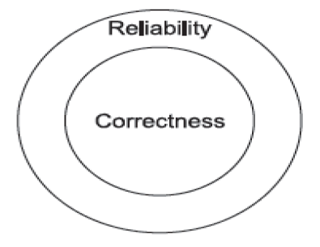
Reliability
Informally, software is reliable if the user can depend on it. The specialized literature on software reliability defines reliability in terms of statistical behavior—the probability that the software will operate as expected over a specified time interval.

Slide 13
Reliability
Reliability is a statistical approximation to correctness, in the sense that 100% reliability is indistinguishable from correctness.
Roughly speaking, reliability is a measure of the likelihood of correct function for some “unit” of behavior, which could be a single use or program execution or a period of time.
Like correctness, reliability is relative to a specification (which determines whether a unit of behavior is counted as a success or failure).
Unlike correctness, reliability is also relative to a particular usage profile. The same program can be more or less reliable depending on how it is used.

Slide 14
Robustness
Robustness: Robustness reduces the impact of operational mistakes, erroneous input data, and hardware errors.
A software system is robust if the consequences of an error in its operation, in the input, or in the hardware, in relation to a given application, are inversely proportional to the probability of the occurrence of this error in the given application.

Slide 15
Robustness
A program is robust if it behaves “reasonably,” even in circumstances that were not anticipated in the requirements specification
for example, when it encounters incorrect input data or some hardware malfunction (say, disk crash).
Obviously, robustness is a difficult-to-define quality

Slide 16
Correctness and reliability
Correctness and reliability are contingent on normal operating conditions.
Software that is “correct” may still fail when the assumptions of its design are violated. How it fails matters.
Software that “gracefully” fails is robust.
Consider events that could cause system failure.
Decide on an appropriate counter-measure to ensure graceful degradation of services.

Slide 17
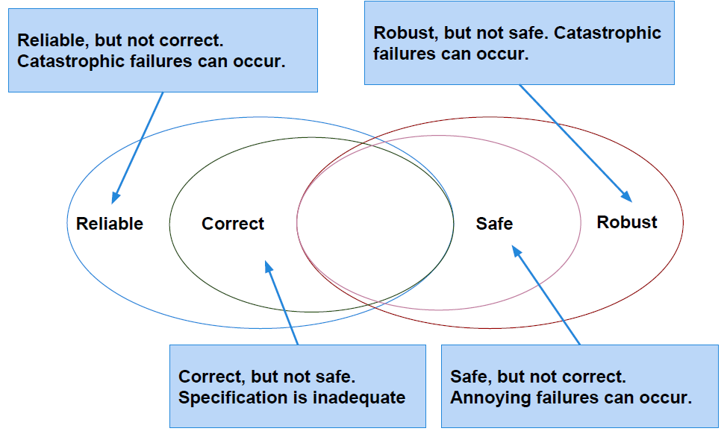

Slide 18
Q: We have stated that 100% reliability is indistinguishable from correctness, but they are not quite identical. Under what circumstance might an incorrect program be 100% reliable?
Hint: Recall that a program may be more or less reliable depending on how it is used, but a program is either correct or incorrect regardless of usage.

Slide 19
Reliability
Particular measures of reliability can be used for different units of execution and different ways of counting success and failure.
Availability is an appropriate measure when a failure has some duration in time.
For example, a failure of a network router may make it impossible to use some functions of a local area network until the service is restored; between initial failure and restoration we say the router is “down” or “unavailable.”
The availability of a system is the proportion of time in which the system is “up” (providing normal service) as a fraction of total time.

Slide 20
Q: We might measure the reliability of a network router as the fraction of all packets that are correctly routed, or as the fraction of total service time in which packets are correctly routed. When might these two measures be different? When might availability be the more useful measure of dependability? When might availability be less useful than the other measure of reliability?

Slide 21
Mean time between failures (MTBF) is yet another measure of reliability, also using time as the unit of execution. The hypothetical network switch that typically fails once in a 24 hour period and takes about an hour to recover has a mean time between failures of 23 hours.
Note that availability does not distinguish between two failures of 30 minutes each and one failure lasting an hour, while MTBF does.

Slide 22
Thanks!
Any questions?
You can find me at:
malenezi@psu.edu.sa

